Slide 1

Web Scraping Using
(Tidyverse Approach)
Prepared by : Aep Hidayatuloh
Email : aephidayatuloh.mail@gmail.com
GitHub : https://github.com/aephidayatuloh

Slide 2
{Pre-requisite}

Slide 3
{Pre-requisite}
Internet Connection
Software Installed:
R program (https://cran.r-project.org/)
RStudio (https://www.rstudio.com/products/rstudio/download/)
Materials:
Download from https://github.com/aephidayatuloh/web_scraping
R Packages:
rvest : install.packages("rvest")
dplyr : install.packages("dplyr")
readr : install.packages("readr")
httr : install.packages("httr")
stringr : install.packages("stringr")
Use install.packages(c("rvest", "dplyr", "readr", "httr", "stringr")) to install all those packages or simply install.packages(c("tidyverse", "rvest", "httr")) to install rvest, dplyr, readr, httr, stringr and other useful packages.

Slide 4
Why Need Web Scraping?

Slide 5
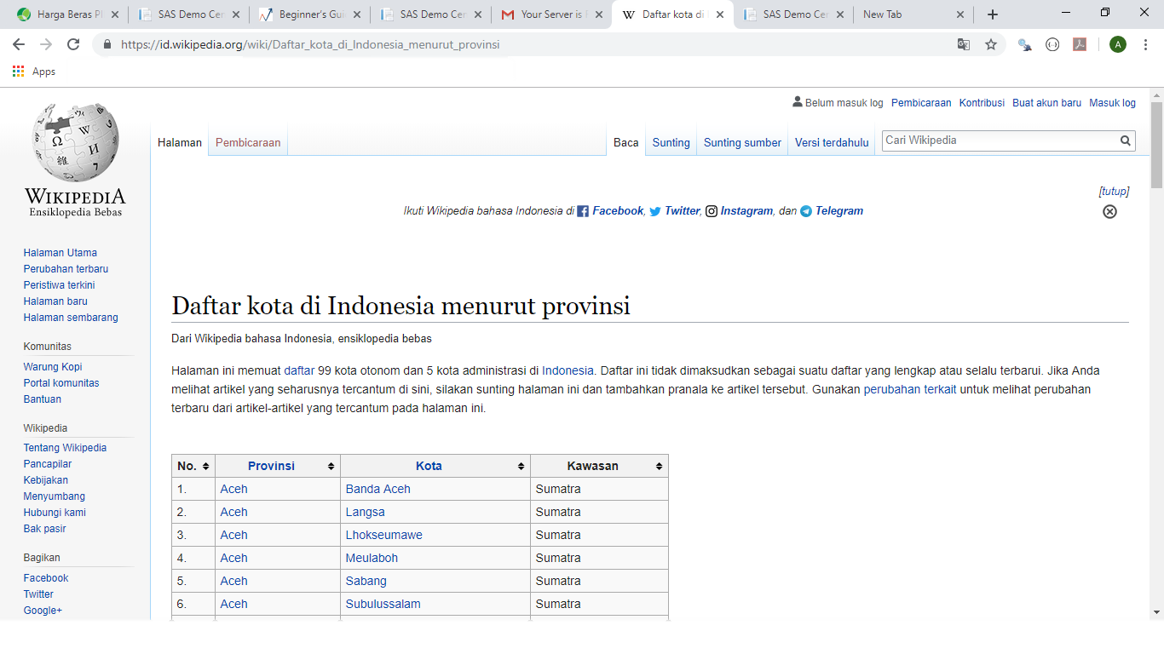
Data From Website

Slide 6


Web Scraping
Website
Data

Slide 7
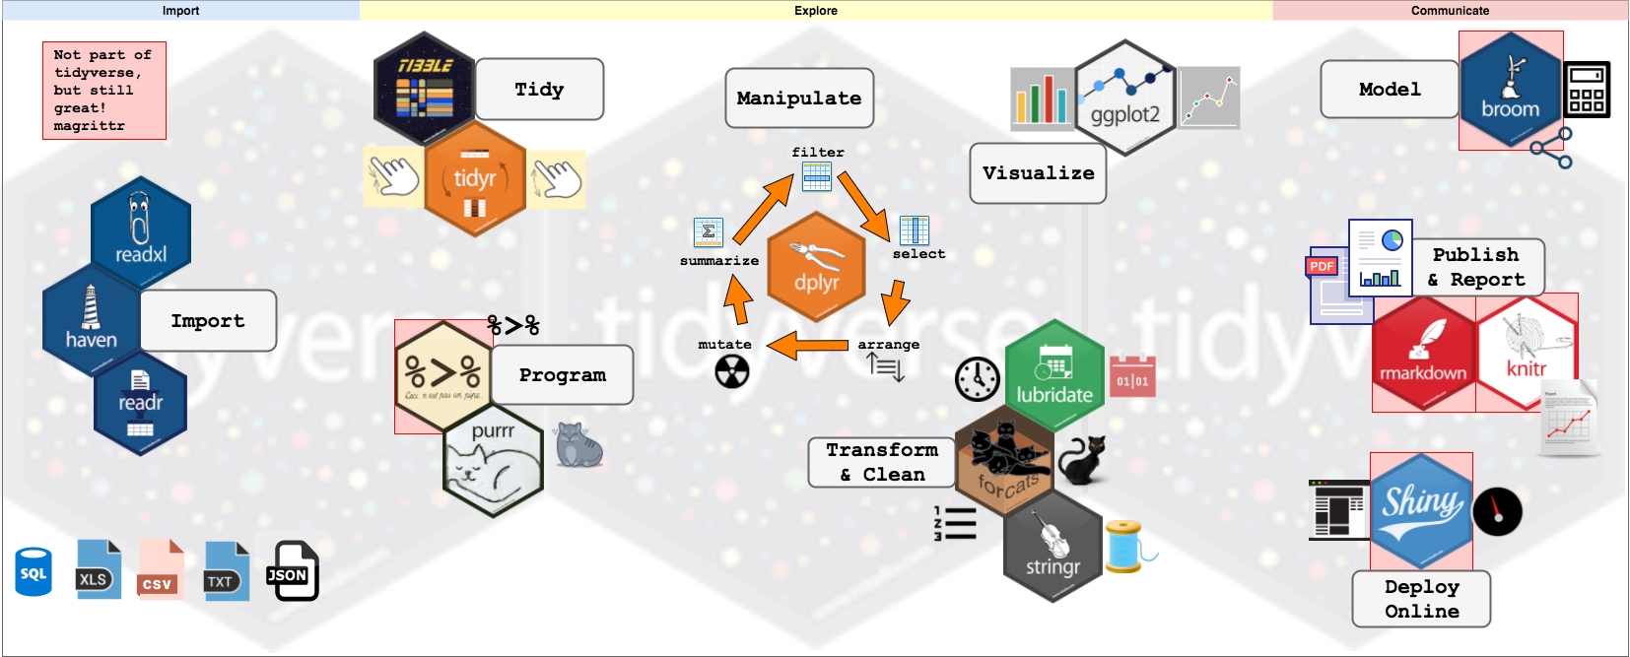
Tidyverse and Universe

Slide 8

The rvest and pipe
Pipeline in R
dplyr imports this operator from another package (magrittr)
It’s the Then
Simple web scraping for R
https://rvest.tidyverse.org
as part (but not core) of tidyverse
scrape information from web pages

Slide 9
Understanding Pipe
# basic way
filter(select(iris, Sepal.Length, Sepal.Width, Species), Species == "virginica")
# pipeline
Iris %>%
select(Sepal.Length, Sepal.Width, Species) %>%
filter(Species == "virginica")
“From Iris dataframe THEN
select Sepal.Length, Sepal.Width and Species column only THEN
filter which Species is virginica”

Slide 10
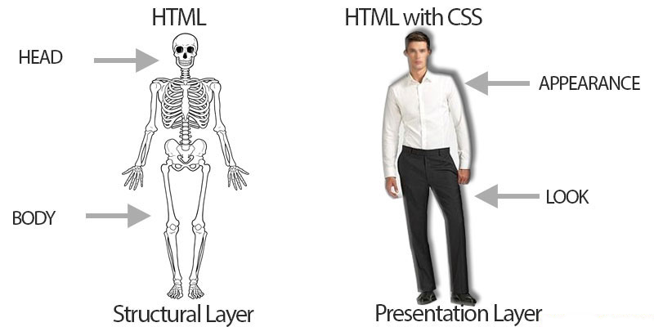
<HTML> & {.#CSS}
Find more about HTML & CSS at https://www.w3schools.com/htmL/html_css.asp

Slide 11
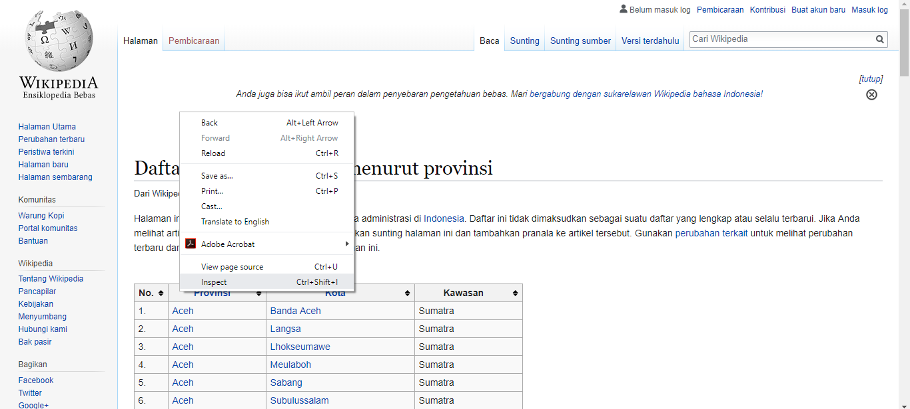
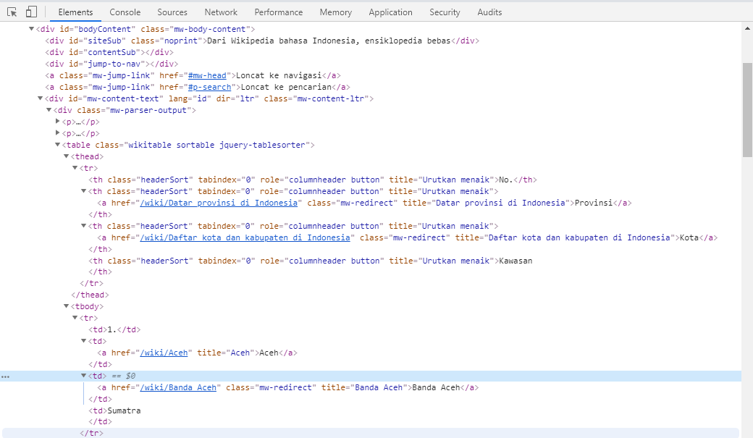
Browser Inspect Element
HTML tags/node
HTML attribute/CSS
HTML text

Slide 12
Request Method: GET & POST
GET :
Parameter(s) from client side to server side visible in URL
Not so secure than POST to transfer data
POST :
Parameter(s) from client side to server side invisible in URL
More secure to transfer data than GET
rvest request method default: GET

Slide 13
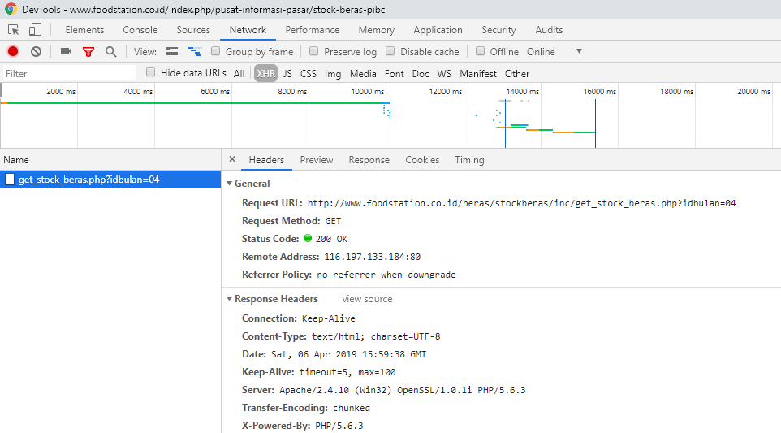
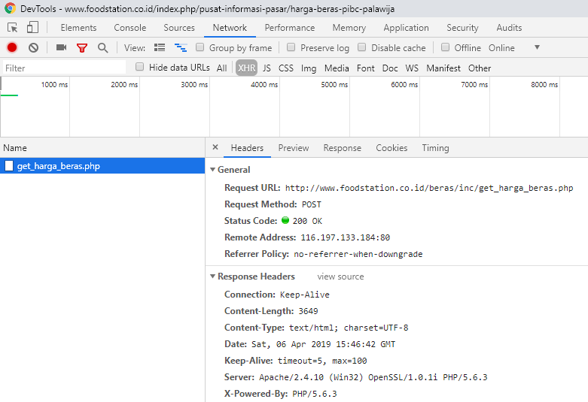
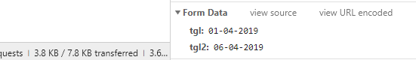
Request Method: GET & POST
GET :
POST :
URL
Request Method
Parameter
rvest request method default: GET

Slide 14
Scrape {Stok & Harga Beras}
Pasar Induk Beras Cipinang (PIBC)
https://www.foodstation.co.id

Slide 15
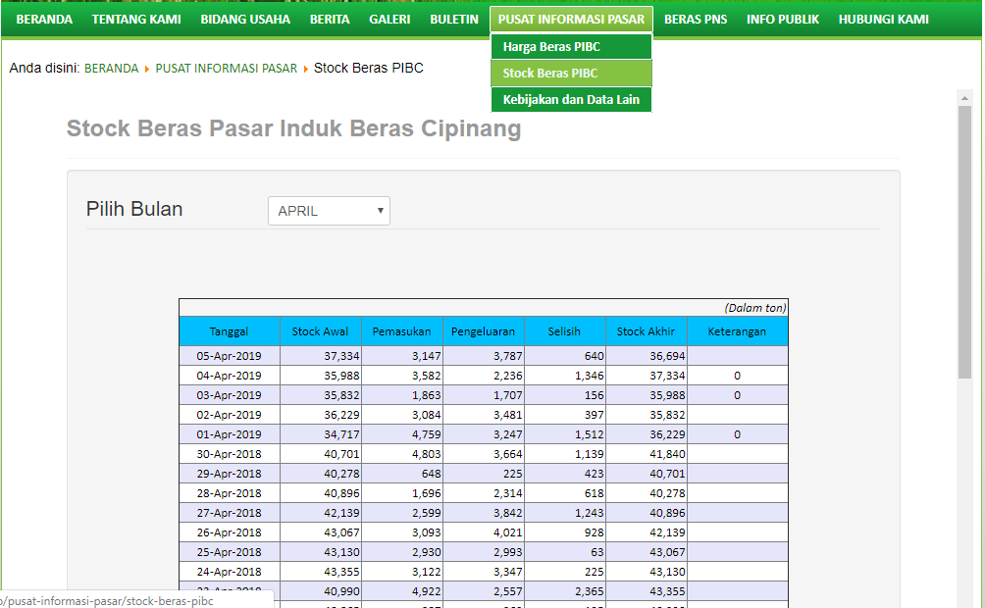
{Stok Beras} – Data

Slide 16
Request Method: GET
GET :
URL
Request Method
Parameter
rvest request method default: GET

Slide 17
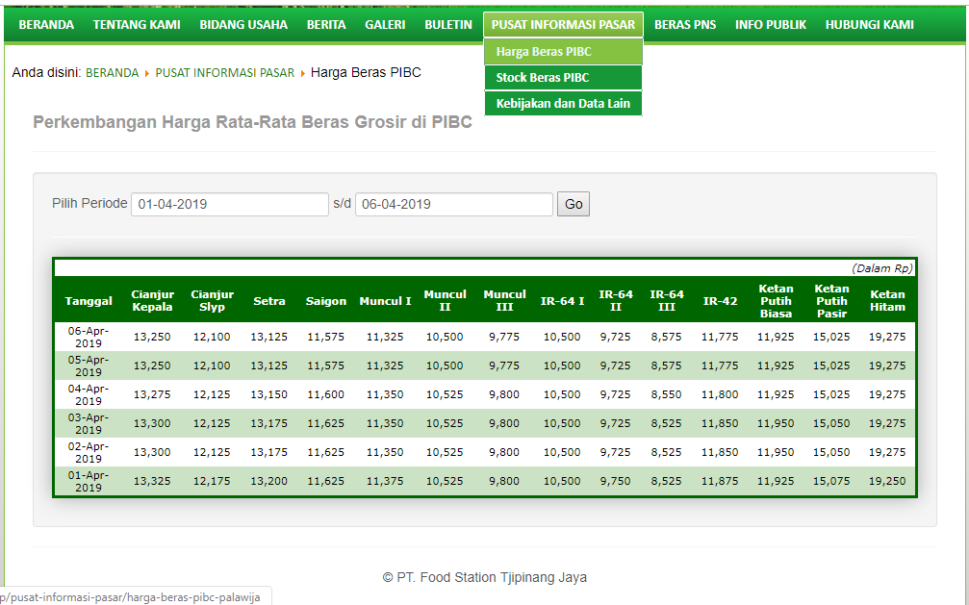
{Harga Beras} – Data

Slide 18
Request Method: POST
POST :
URL
Request Method
Parameter

Slide 19
??? {Q & A}

Slide 20
ThankQ

